Slide 1
no-touch technology!! Sanitization of Disabled's belongings and their equipments using UVC light
By: Team Buffer Circuitz
BIT Sindri

Slide 2
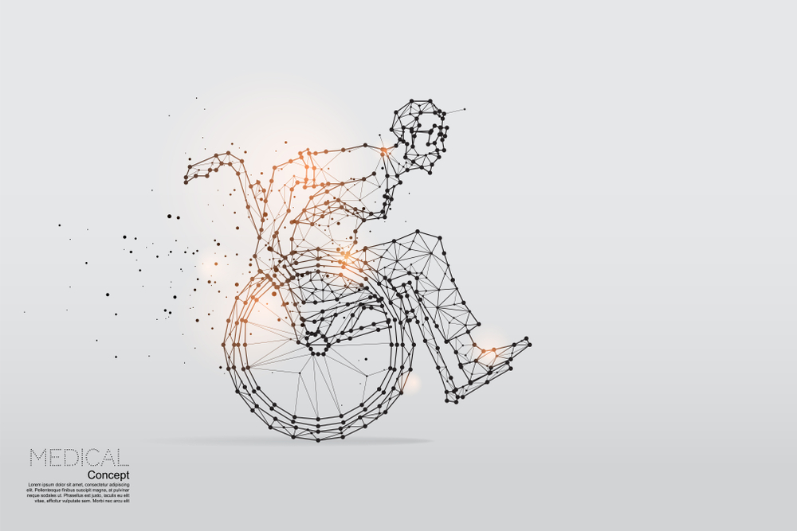
Problem faced by DIFFERENTLY-abled people
Self isolation
Social distancing
Focused group
Physical Impairment disability
1.1. Cerebral Palsy
1.2. Spina Bifida
1.3. Spinal cord injury
1.4. Stroke
1.5. Brain Injury
1.6. Polio

Slide 3
Our methodology
Daily articles sanitization- By designing a device called “Disinfectento”.
Future Implementation of UVC sanitization using drone in School/house interior.

Slide 4


Prototype Developed: Work flow
CAD model
Hardware Electronics
Integration of hardware design with electronics
Final prototype
SUBTITLE GOES HERE

Slide 5
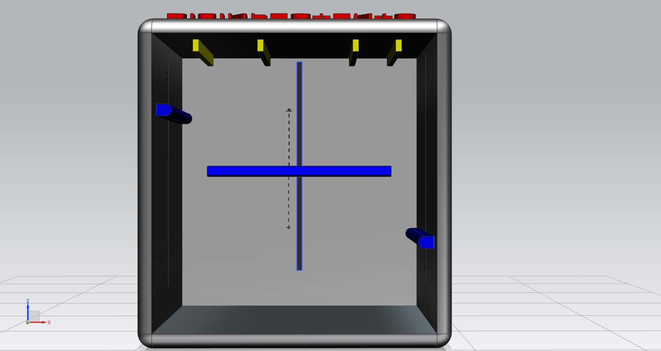
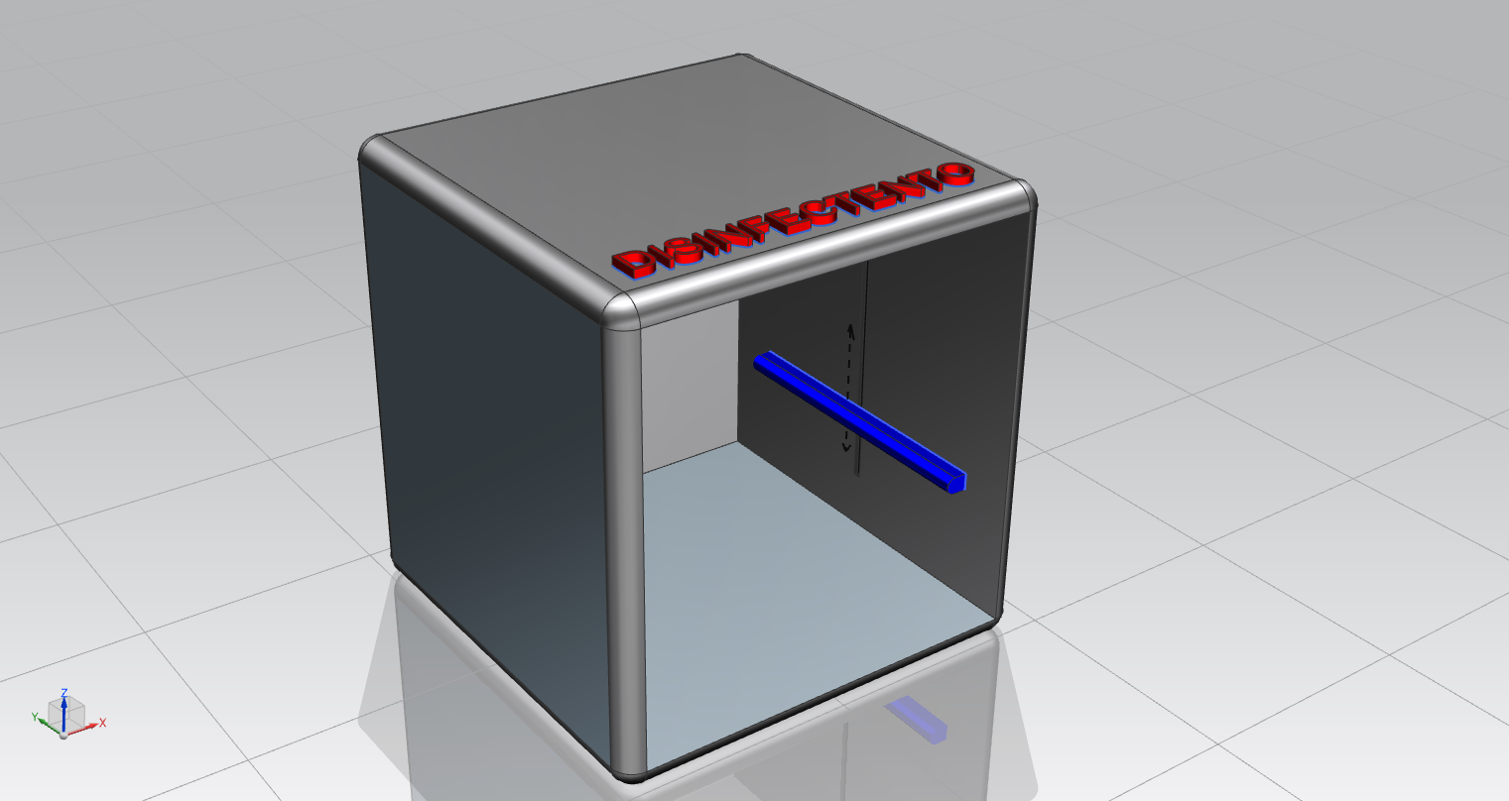
CAD prototype developed
FRONT VIEW
ISOMETRIC VIEW
DISINFECTENTO

Slide 6
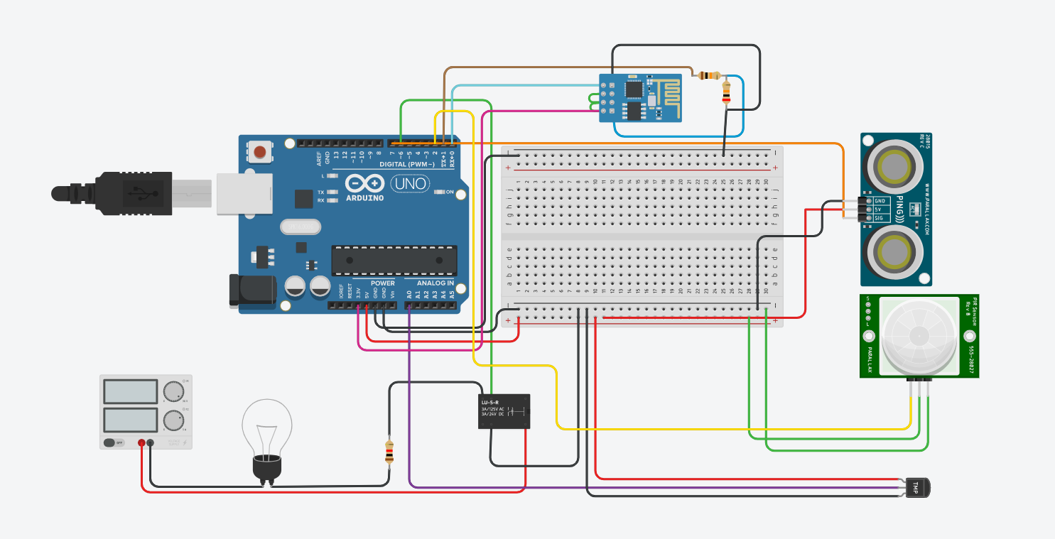
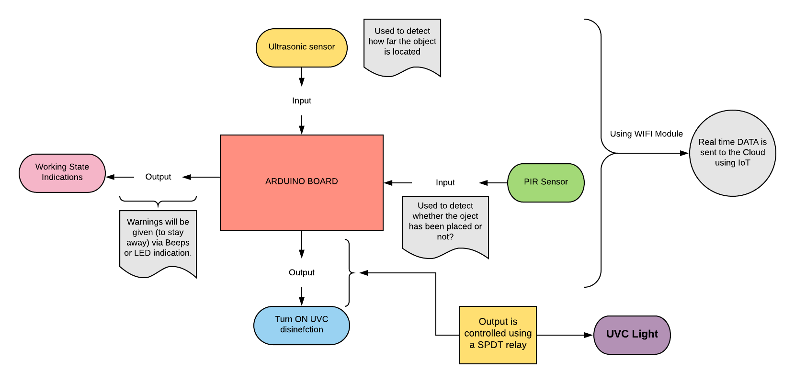
Electronics developed and simulations
Circuit
Circuit workflow

Slide 7
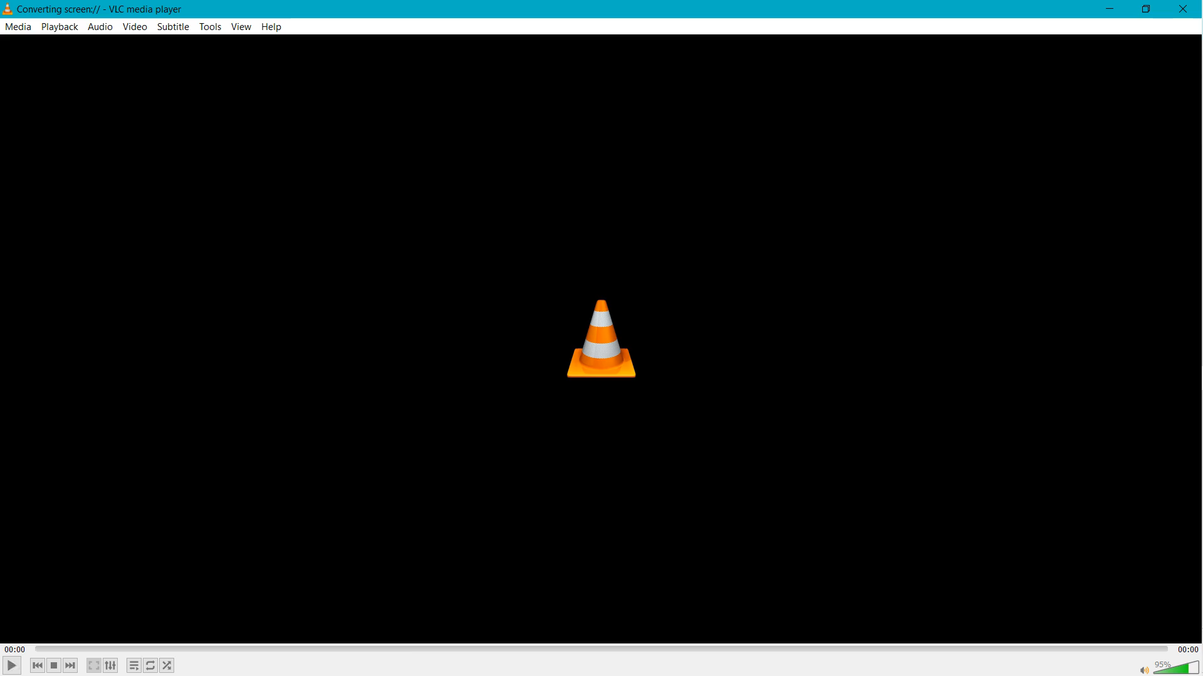
Electronic Simulations

Slide 8
Final Prototype developed
FEATURES OF THE PROTOTYPE
Uses 11w UVC sanitization light.
0.05-o.25 mW for 1 by 1 m
Dimensions of (1m*1m*1m).
Light weight and portable
Will sanitise equipment used by disabled like wheelchair, crutches , walker and other day to day articles.
Inner mirrored surfaces to increase efficiency of sanitisation.
Steel body with smooth touch.
Easily placeable shelfs.
Glass door for clear monitoring.
The user interface is easy to use.
Human voice warning.
IoT control

Slide 9
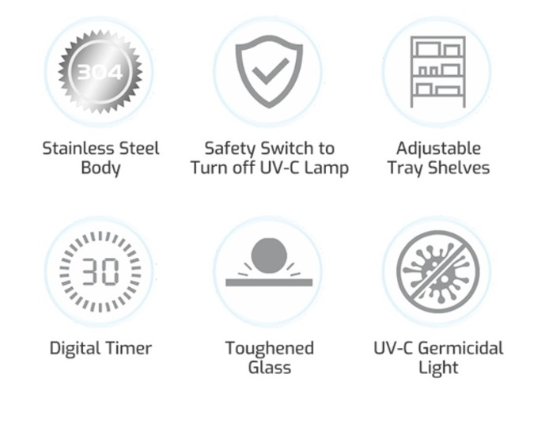
Key features

Slide 10
Cost analysis and effectiveness
According to the research analysis, the pre-existing products in the market reveals that the cost is around 10k to 25k.
Cost Analysis of “DISINFECTENTO”-
We are here to develop an effective solution for sanitization of daily equipments specially for disabled .
Cost- 4k – 5k.
The products already existing like one’s developed by IIT Bhubaneswar costs around 6k-7k and is meant to cleanse just normal daily gadgets like smartphones and dish plates
No Device has been prototyped with disabled Sanitisation in mind.

Slide 11
Conclusion
1.The Disinfectento designed to make sure the complete eradication of the viruses from the surfaces.
2. This device make sure that the essentials of the disabled people gets disinfected which is not given prime focus to this part of our society.

Slide 12
Team members
1. Akash saw – (Branch Electrical)- working on electronics, circuit simulations, IoT . 2. Deepali kumari – (Branch Electrical)-working on coding parts of the prototype and machine learning. 3. Nishu kumari – (Branch Chemical) -prototype research, presentations and MATLAB representation. 4. Pravin kr. Tripathi- (Branch Mechanical) – the architectural designing of the prototype on CAD software.

